Slide 1
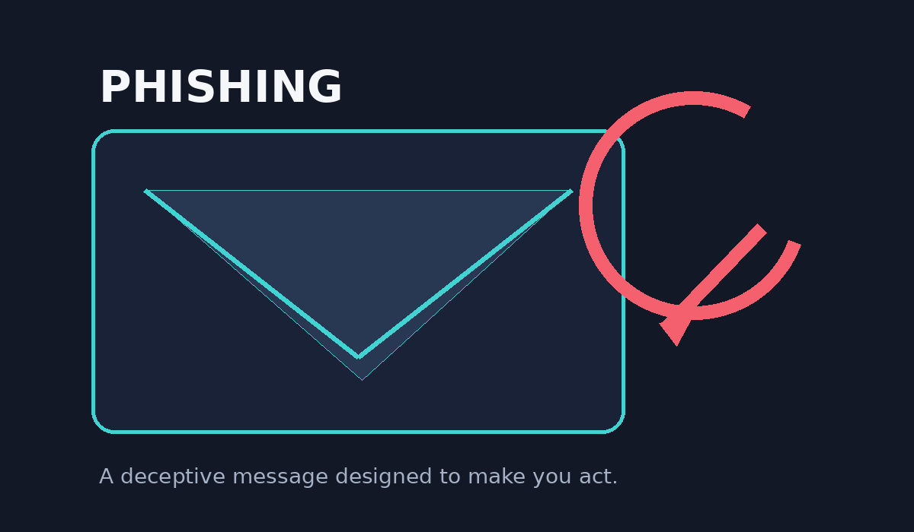
CYBERSECURITY AWARENESS
PHISHING
AWARENESS TRAINING
Recognize • Verify • Protect
PROJECT
Name: Sakshi Jadhav
Class / Department: Ty(ENTC)
PHISHING AWARENESS • CYBERSECURITY PROJECT • 01

Slide 2
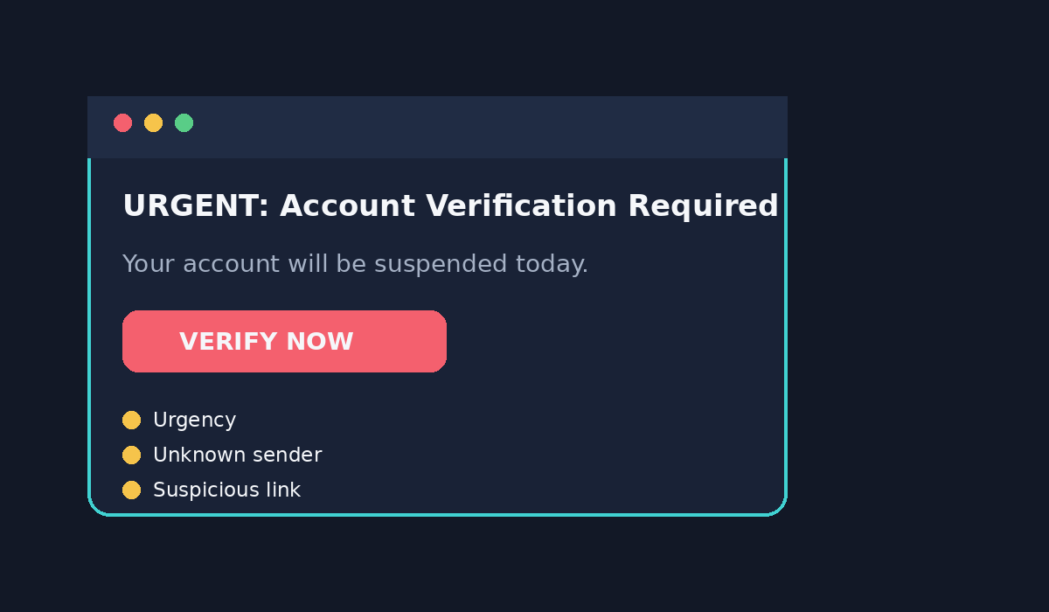
01 • FUNDAMENTALS
What is phishing?
A social-engineering attack that uses deception to make a person reveal information or take an unsafe action.
THE GOAL
Steal credentials, financial information, personal data, or gain unauthorized access.
THE TRICK
Impersonate a trusted brand, person, service, or authority.
THE SIGNAL
Unexpected urgency + request for action + suspicious link or attachment.
PHISHING AWARENESS • CYBERSECURITY PROJECT • 02

Slide 3
02 • ATTACK TYPES
Know the common forms
Different channels, same objective: manipulate the target.
EMAIL PHISHING
SPEAR PHISHING
SMISHING
Fraudulent email
Channel: E-mail
Targeted at a specific person
Channel: Target
Malicious SMS/text
Channel: SMS
VISHING
CLONE PHISHING
WEBSITE PHISHING
Fraudulent phone call
Channel: Voice
Imitates a legitimate message
Channel: Copy
Fake login or payment page
Channel: Web
PHISHING AWARENESS • CYBERSECURITY PROJECT • 03

Slide 4
03 • EMAIL INSPECTION
How to spot a phishing email
Pause before clicking. Inspect the message instead of reacting to the pressure.
01 SENDER
Check the complete address and unexpected domain.
02 PRESSURE
Urgency, fear, or threats are common manipulation signals.
03 REQUEST
Be cautious with password, OTP, payment, or personal-data requests.
04 LINK / FILE
Hover/check the destination and avoid unexpected attachments.
PHISHING AWARENESS • CYBERSECURITY PROJECT • 04

Slide 5
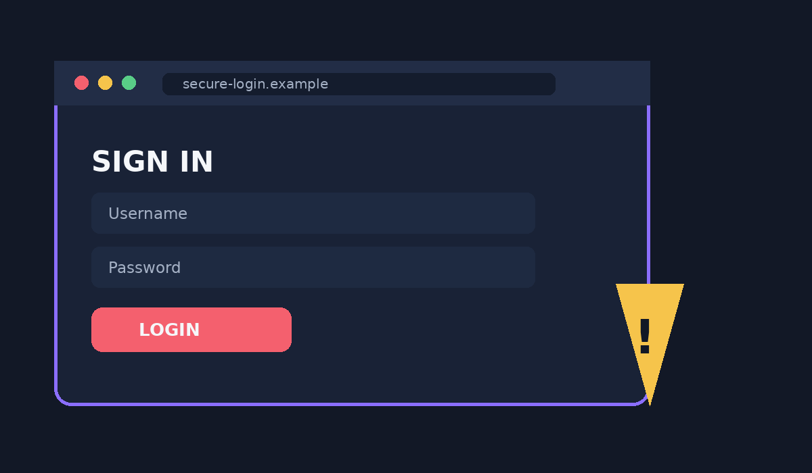
04 • WEBSITE INSPECTION
A padlock is not proof of legitimacy
HTTPS encrypts the connection; it does not certify that the website itself is trustworthy.
CHECK THE DOMAIN
Look for misspellings, unexpected subdomains, or unfamiliar domains.
VERIFY THE SOURCE
Open the official app/site yourself instead of following an unexpected link.
CHECK THE REQUEST
Stop if the page unexpectedly asks for sensitive information.
PHISHING AWARENESS • CYBERSECURITY PROJECT • 05

Slide 6
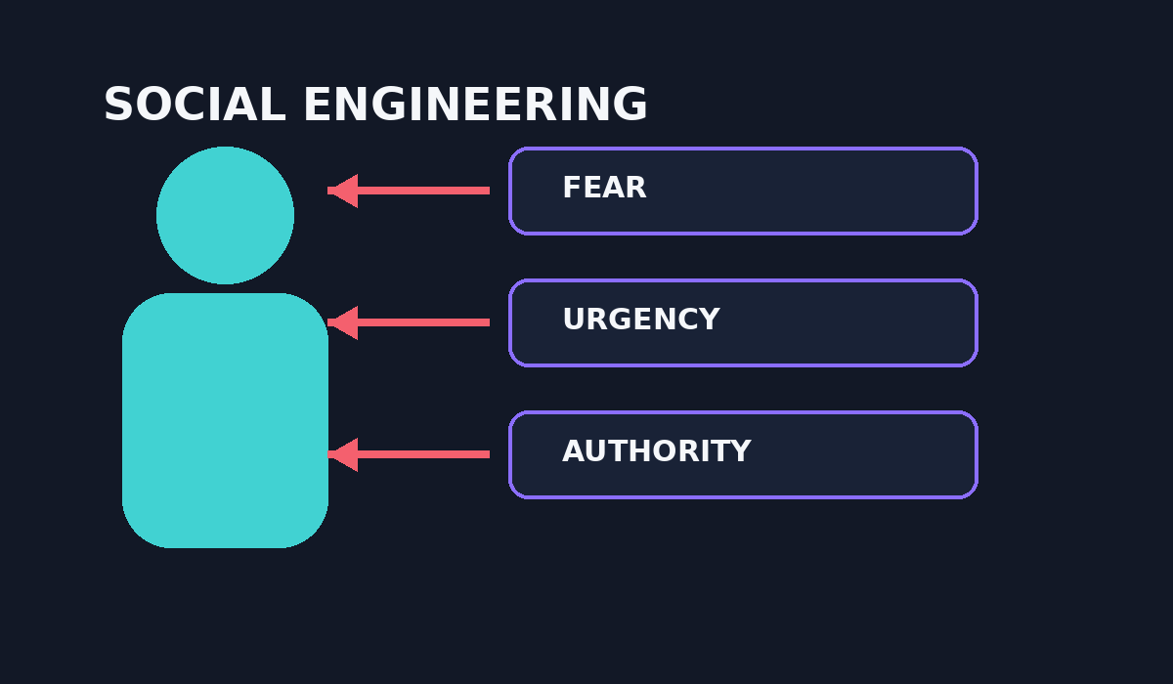
05 • HUMAN FACTOR
Social engineering: attacking trust
Attackers often exploit emotions and habits rather than technical vulnerabilities.
FEAR
“Your account has been compromised.”
URGENCY
“You have 10 minutes to respond.”
AUTHORITY
Pretending to be a bank, manager, teacher, or official.
REWARD / CURIOSITY
Prize, refund, exclusive offer, or tempting content.
PHISHING AWARENESS • CYBERSECURITY PROJECT • 06

Slide 7
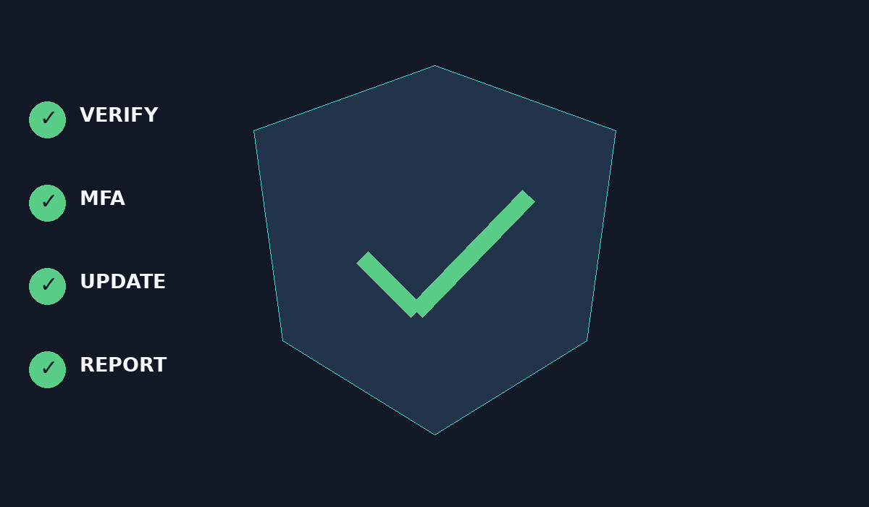
06 • DEFENSE
Best practices that reduce risk
Good security habits turn a suspicious message into a safe decision.
VERIFY
Use an independent official channel.
MFA
Enable multi-factor authentication.
PASSWORDS
Use strong, unique passwords.
UPDATES
Patch your OS, browser, and apps.
REPORT
Report suspicious messages to the appropriate service.
PHISHING AWARENESS • CYBERSECURITY PROJECT • 07

Slide 8
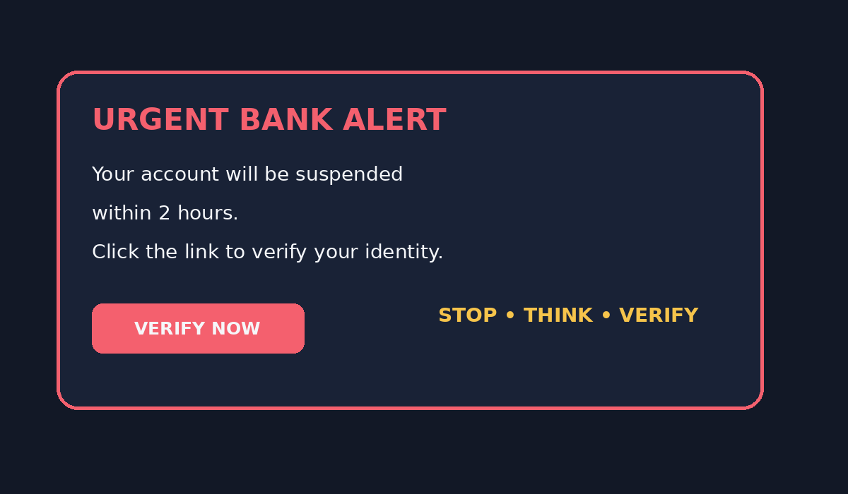
07 • SCENARIO
Can you spot the red flags?
Read the message first. Decide what you would do before viewing the answer.
RED FLAG 01
Artificial deadline: “within 2 hours.”
RED FLAG 02
Unexpected request to verify your account.
SAFE RESPONSE
Do not click. Verify independently through the official bank app/site.
PHISHING AWARENESS • CYBERSECURITY PROJECT • 08

Slide 9
08 • KNOWLEDGE CHECK
Interactive quiz
Use this slide as a live classroom quiz before revealing the answers.
Q1
Q2
An urgent message says your account will be blocked today. What should you do?
A Click B Share C Verify independently D Send OTP
Does HTTPS automatically prove a website is genuine?
A Yes B No
Q3
Q4
Smishing is phishing delivered through:
A Email B SMS C Phone call D USB
What should you do with a suspicious email?
A Click B Share password C Verify + report/delete D Send OTP
PHISHING AWARENESS • CYBERSECURITY PROJECT • 09

Slide 10
09 • ANSWER KEY
Quiz answers + reasoning
The goal is not just the right answer—it is the habit behind it.
Q1
Q2
Q3
Q4
C — Verify independently
Don't use the message's link.
B — No
HTTPS protects the connection, not the site's intent.
B — SMS
Smishing = SMS phishing.
C — Verify + report/delete
Avoid engaging with the suspicious message.
STOP → THINK → VERIFY → REPORT
A few seconds of verification can prevent a costly mistake.
PHISHING AWARENESS • CYBERSECURITY PROJECT • 10

Slide 11
10 • TAKEAWAY
Your phishing defense checklist
When a message creates pressure, slow down.
Unexpected message? → PAUSE
Unknown sender or link? → INSPECT
Sensitive request? → VERIFY
Still suspicious? → DON'T CLICK
Confirmed phishing? → REPORT
Think before you click. Protect your identity, accounts, and organization.
PHISHING AWARENESS • CYBERSECURITY PROJECT • 11

